Slide 1
Me: Yoav Zibin
B.A. in computer science , Technion 1998-99
  Excellence program, finished in 2 years
  GPA: 98.2 (highest among all faculties that year)
Ph.D. in computer science, Technion 2000-04
  Transferred from M.Sc. to direct Ph.D. studies
CTES scholarship in UCL, London 2005
  Short MBA, focus on technology transfer
Postdoc in MIT, Boston 2007
CTO and Co-founder of Come2Play 2008-09
  Platform for multiplayer games
Notes:
Object immutability - Immutable instances may not be mutated, while mutable instances (of the same class) may

Slide 2
My papers
Thesis: Runtime of OO languages
  OOPSLA’01 & ’02, POPL’03, ECOOP’03
  Extended to 3 journal papers in TOPLAS
Type Isomorphism
  POPL’03
  Extended in 2 journal papers in MSCS
Distributed Systems
  DISC’03 – Consensus problem
Operating Systems
  SOSP’09 - Automatically patching errors
Software Engineering: Immutability
  FSE’07 – Best paper award (focus of this talk)
  Now submitting an extension with Ownership
Technion
MIT
Notes:
Object immutability - Immutable instances may not be mutated, while mutable instances (of the same class) may

Slide 3
Thesis: OO Runtime Environment
Tasks
  Subtyping Tests
  Single Dispatching
  Multiple Dispatching
  Field Access (Object Layout)
Variations
  Single vs. Multiple Inheritance
  Statically vs. Dynamically typed languages
  Batch vs. Incremental
Notes:
Type hierarchy H=(T,≺)
Type Conformance, Inclusion Polymorphism
Batch (e.g., Eiffel)
the whole hierarchy is given at compile-time
Incremental (e.g., Java)
the hierarchy is built at runtime

Slide 4
Thesis: Results
Subtyping Tests [OOPSLA’01, TOPLAS]
  “Efficient Subtyping Tests with PQ-Encoding” (patented)
  Constant time subtyping tests with best space requirements
Single and Multiple Dispatching [OOPSLA’02]
  “Fast Algorithm for Creating Space Efficient Dispatching Tables with Application to Multi-Dispatching”
  Logarithmic dispatch time & almost linear space
Single Dispatching [POPL’03 , TOPLAS]
  “Incremental Algorithms for Dispatching in Dynamically Typed Languages”
  Constant dispatch time: more dereferencing ⇒ less memory
Object Layout [ECOOP’03, TOPLAS]
  “Two-Dimensional Bi-Directional Object Layout”
  No this-adjustment, no compiler generated fields, and favorable field-access time

Slide 5
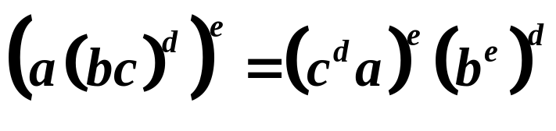
Type Isomorphism Results
?
“Efficient Algorithms for Isomorphism of Simple Types” [POPL’03, MSCS’05]
  A surprising application of thesis techniques
  First-order isomorphism: n² log n ⇒ n log² n
Randomized Algorithms [MSCS’07]
  O(n) time Monte Carlo
  O(n log n) expected time and O(n) space Las Vegas

Slide 6
Object and Reference Immutability using Java Generics
Yoav Zibin, Alex Potanin(*), Mahmood Ali, Shay Artzi, Adam Kiezun, and Michael D. Ernst
MIT Computer Science and Artificial Intelligence Lab, USA
* Victoria University of Wellington, New Zealand

Slide 7
Immutability – What for?
Program comprehension
Verification
Compile- & run-time optimizations
Invariant detection
Refactoring
Test input generation
Regression oracle creation
Specification mining
Modelling

Slide 8
Immutability varieties
Class immutability
  No instance of an immutable class can be mutated after creation (e.g., String, Integer)
Object immutability
  The same class may have both mutable and immutable instances
Reference immutability
  A particular reference cannot be used to mutate its referent (but other aliases might cause mutations)
Notes:
Object immutability - Immutable instances may not be mutated, while mutable instances (of the same class) may

Slide 9
Previous work
Access rights
  Java with Access-Control (JAC)
    readnothing < readimmutable < readonly < writeable
  Capabilities for sharing
    Lower-level rights that can be enforced at compile- or run- time
Reference immutability:
  Universes (ownership + reference immutability)
  C++’s const
  Javari
Notes:
No typing rules for object immutability
A mode system for read-only references in Java. Mats Skoglund and Tobias
Wrigstad. FTFjP 2001.

Slide 10
IGJ - Immutability Generic Java
Class immutability
  All instances are immutable objects
Object immutability:
  An object: mutable or immutable
Reference immutability:
  A reference: mutable, immutable, or readonly

Slide 11
IGJ syntax
1: // An immutable reference to an immutable date;
// Mutating the referent is prohibited, via this or any other reference.
Date<Immutable> immutD = new Date<Immutable>();
2: // A mutable reference to a mutable date;
// Mutating the referent is permitted, via this or any other reference.
Date<Mutable> mutD = new Date<Mutable>();
3: // A readonly reference to any date;
// Mutating the referent is prohibited via this reference.
Date<ReadOnly> roD = ... ? immutD : mutD;
Java syntax is not modified:
One new generic parameter was added
Some method annotations were added (shown later)
Notes:
Syntax is the same, but not the typing rules!
Line 3 s
Start mentioning the co-variance problem in java:
Date<Immutable> is not a subtype of Date<ReadOnly> in Java.

Slide 12
IGJ design principles
Transitivity
  Transitive (deep) immutability protects the entire abstract state from mutation
  Mutable fields are excluded from the abstract state
Static
  No runtime representation for immutability
Polymorphism
  Abstracting over immutability without code duplication
Simplicity
  No change to Java’s syntax; a small set of typing rules

Slide 13
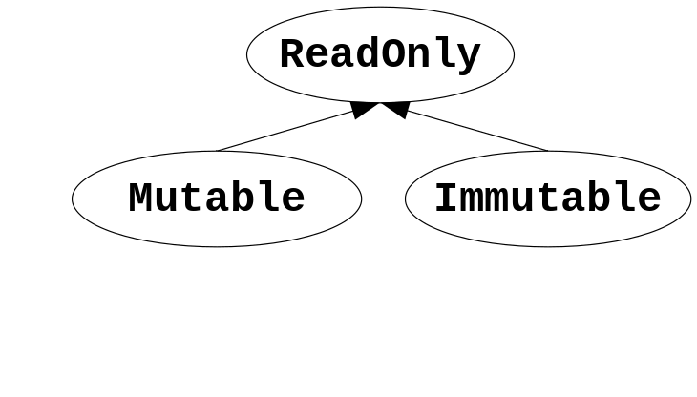
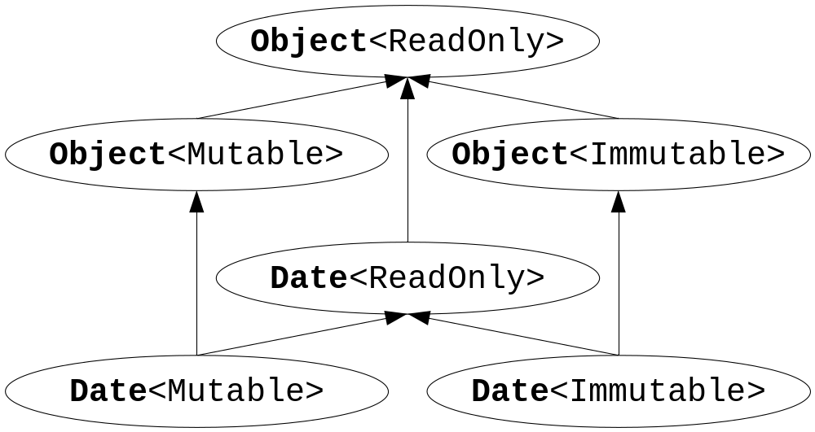
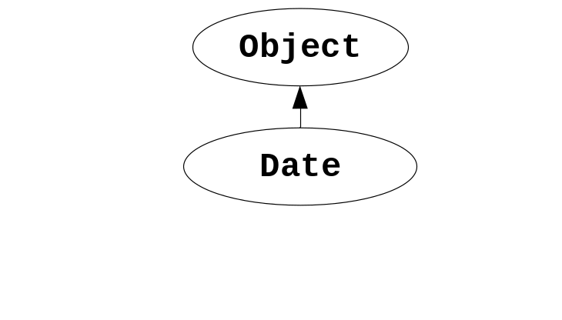
Hierarchies in IGJ
Immutability parameters hierarchy
The subclass hierarchy for Object and Date
The subtype hierarchy for Object and Date

Slide 14
Covariance problem and immutability
void foo(ArrayList<Object> a) { … }
foo(new ArrayList<Object>()); // OK
foo(new ArrayList<String>()); // Compilation error!
void foo(Object[] a) { a[0] = new Integer(1); }
foo(new Object[42]); // OK, stores an Integer in an Object array
foo(new String[42]); // Causes ArrayStoreException at runtime
IGJ’s Solution:
  ReadOnly, Immutable – allow covariance
  Mutable – disallow covariance
List<ReadOnly,String> is a subtype of List<ReadOnly,Object>
List<Mutable,String> is NOT a subtype of List<Mutable,Object>

Slide 15
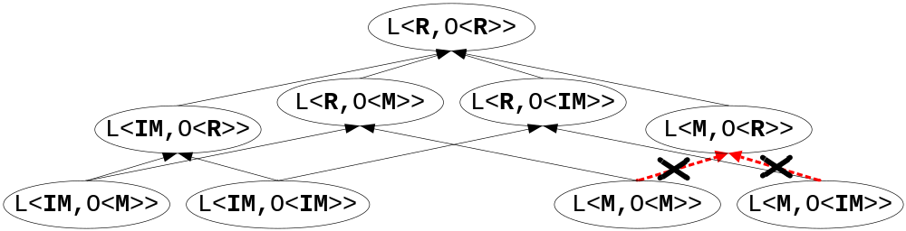
IGJ subtype hierarchy
Example: A list of objects
Legend:
L = List
O = Object
R = ReadOnly
IM = Immutable
M = Mutable
For example:
L<R,O<M>> means List<ReadOnly,Object<Mutable>>

Slide 16
IGJ typing rules
There are several typing rules
(next slides)
  Field assignment
Immutability of this
  Method invocation
Let I(x) denote the immutability of x
  Example:
  Date<Mutable> d;
  I(d) is Mutable

Slide 17
Field assignment rule
o.someField = …;
is legal iff I(o) = Mutable
Example:
  Employee<ReadOnly> roE = …;
  roE.address = …; // Compilation error!

Slide 18
Immutability of this
this immutability is indicated by a method annotation
  @ReadOnly, @Mutable, @Immutable
We write I(m.this) to show the context of this
Example:
  @Mutable void m() {... this ...}
  I(m.this) = Mutable
Notes:
this immutability depends on the context
is the same as the method immutability

Slide 19
Method invocation rule
o.m(...)
is legal iff I(o) is a subtype of I(m.this)
1: Employee<Mutable> mutE = ...;
2: mutE.setAddress(...); // OK
3: mutE.getAddress(); // OK
4: Employee<ReadOnly> roE = mutE;
5: roE.setAddress(...); // Compilation error!

Slide 20
Reference immutability (ReadOnly)
1 : class Edge<I extends ReadOnly> {
2 : long id;
3 : @Mutable Edge(long id) { this.setId(id); }
4 : @Mutable void setId(long id) { this.id = id; }
5 : @ReadOnly long getId() { return this.id; }
6 : @ReadOnly Edge<I> copy() { return new Edge<I>(this.id); }
7 : static void print(Edge<ReadOnly> e) {... }
8 : }
10: class Graph<I extends ReadOnly> {
11: List<I,Edge<I>> edges;
12: @Mutable Graph(List<I,Edge<I>> edges) { this.edges = edges; }
13: @Mutable void addEdge(Edge<Mutable> e) { this.edges.add(e);}
14: static <X extends ReadOnly>
15: Edge<X> findEdge(Graph<X> g, long id) { ... }
16: }
Notes:
Using only Mutable&ReadOnly (no Immutable)
The bold is the new additions for immutability. Without them it is normal java code.
A class can pass its immutability parameter to:
its fields (line 11), parameters (line 12), return type, and locals
Line 12: Deep transitivity - in an immutable Graph the field l will contain an immutable list of immutable edges

Slide 21
Object immutability: Motivation
Compile- & run-time optimizations
Program comprehension
Verification
Invariant detection
Test input generation
...
Example: Immutable objects need no synchronization
@ReadOnly synchronized long getId() { return id; }
@Immutable long getIdImmutable() { return id; }

Slide 22
Object immutability: Challenge
1: class Edge<I extends ReadOnly> {
2: private long id;
3: @????????????? Edge(long id) { this.setId(id); }
4: @Mutable void setId(long id) { this.id = id; }
Challenge: How should the constructor be annotated?
  @Mutable ?
    A mutable alias for this might escape
  @Immutable or @ReadOnly ?
    Cannot assign to any field, nor call this.setId

Slide 23
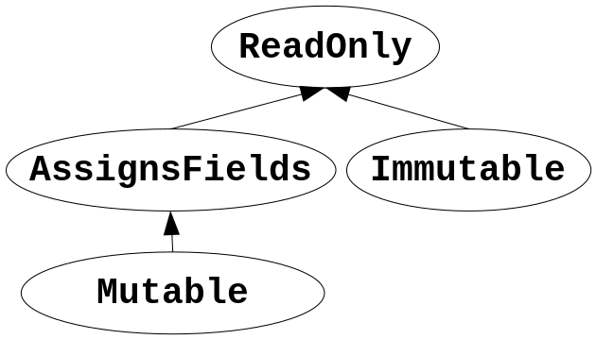
Object immutability: Solution
1: class Edge<I extends ReadOnly> {
2: private long id;
3: @AssignsFields Edge(long id) { this.setId(id); }
4: @AssignsFields void setId(long id) { this.id = id; }
5: Edge<I> e;
6: @Mutable void foo(long id) { this.e.id = id; }
@AssignsFields
  Can only assign to the fields of this,
  i.e., it is not transitive
  Private: cannot write Date<AssignsFields>
  Conclusion: this can only escape as ReadOnly

Slide 24
Object creation rule
new SomeClass<X,…>(…)
is illegal iff the annotation Y of the constructor satisfies:
  Y=@Mutable and X≠Mutable
  Y=@Immutable and X≠Immutable
Examples:
  When Y=@AssignsFields, you can create both Mutable and Immutable instances, e.g.,
    new Edge<Mutable>(this.id);
    new Edge<I>(this.id);
  When Y=@Mutable, you can create only Mutable instances
  When Y=@Immutable, you can create only Immutable instances

Slide 25
Case studies
IGJ compiler
  Small and simple extension of javac
  Using the visitor pattern for the AST
  Modified isSubType according to IGJ’s covariant subtyping
Case studies:
  Jolden benchmark, htmlparser, svn client
  328 classes (106 KLOC)
  113 JDK classes and interfaces
Notes:
AST = Abstract Syntax Tree

Slide 26
Case studies conclusions
Representation exposure errors
  In htmlparser: constructor takes an array and assigns it to a field, without copying; an accessor method also returns that array
Conceptual problems
  In Jolden: an immutable object is mutated only once immediately after it creation.
  We refactored the code, inserting the mutation to the constructor
Found both immutable classes and objects
  Date, SVNURL, lists
Notes:
AST = Abstract Syntax Tree

Slide 27
See the paper for ...
CoVariant and NoVariant type parameters
Method overriding
Mutable and assignable fields
Inner classes
Circular immutable data-structures
Formal proof (Featherweight IGJ)
Notes:
IGJ is powerful enough to handle circularity
Field initializers
Exceptions
Reflection
Arrays

Slide 28
Conclusions
Immutability Generic Java (IGJ)
  Both reference, object, and class immutability
  Simple, intuitive, small, no syntax changes
  Static – no runtime penalties (like generics)
  Backward compatible, no JVM changes
  High degree of polymorphism using generics and safe covariant subtyping
Case study proving usefulness
Formal proof of soundness
Notes:
Field initializers
Exceptions
Reflection
Arrays

Slide 29
Future work
Add default immutability
class Graph<I extends ReadOnly default Mutable>
An alternative syntax
(in JSR 308 for Java 7)
new @mutable ArrayList<@immutable Edge>(...)
Runtime support (e.g. down-cast)

Slide 30
The End!
Notes:
Object immutability - Immutable instances may not be mutated, while mutable instances (of the same class) may

Slide 31
Immutable cyclic datastructures
1: class BiNode<I extends ReadOnly> {// Bi-directional list in IGJ
2: BiNode<I> prev, next;
3: @AssignsFields BiNode(int len, BiNode<I> p) {
4: next = len==0 ? null : new BiNode<I>(len-1, this);
5: prev = p;
6: }
7: ...
8: }
9: BiNode<Immutable> l = new BiNode<Immutable>(42,null);
Problem: existing code is not recursive
  Next slide: Sun’s LinkedList existing code
Notes:
Field initializers
Exceptions
Reflection
Arrays

Slide 32
Sun’s LinkedList in IGJ
1: class LinkedList<I extends ReadOnly,E> {
2: Entry<I,E> header = new Entry<I,E>();
3: @AssignsFields LinkedList(Collection<ReadOnly,E> c) {
4: Entry<I,E> succ = header;
5: for (E e : c) { ...
6: succ.next = ...; // Illegal in IGJ because
7: succ.prev = ...; // AssignsFields is not transitive
8: }
9: }
Problem: mutating objects after the constructor finishes
Solution: use ownership information
  E.g., the list owns its entries
Notes:
Field initializers
Exceptions
Reflection
Arrays

Slide 33
IGJ + Ownership = OIGJ
1: class LinkedList<O extends World,I extends ReadOnly,E> {
2: Entry<Dominator,I,E> header; // the list owns the header
3: …
4: }
5: class Entry<O extends World,E> {
2: Entry<O,I,E> next; // next has the same owner
3: …
4: }
Entries cannot be assigned from the outside nor leak.
Entries from different lists cannot be mixed.
Notes:
Field initializers
Exceptions
Reflection
Arrays

Slide 34
Ownership kinds
Owner-as-dominator
  All reference chains to an object pass via its owner.
  I.e., objects cannot leak outside their owner.
Owner-as-modifier
  All modifications to an object is done by its owner.
  Objects may leak, but only as readonly.
World
Dominator
Modifier
Notes:
Field initializers
Exceptions
Reflection
Arrays

